Slide 1
Managing source code
Introduction to GIT

Slide 2
Branches
By default, there is a single branch named Master
A new branch is simply a clone of the existing branch
Master
Dev Branch
Bug Branch

Slide 3
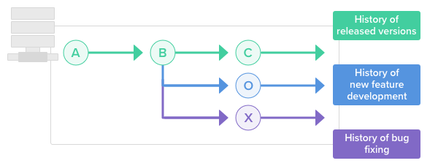
Branches
A Git branch is essentially an independent line of development. You can take advantage of branching when working on new features or bug fixes because it isolates your work from that of other team members.
Different branches can be merged into any
one branch as long as they belong to the
same repository.

Slide 4
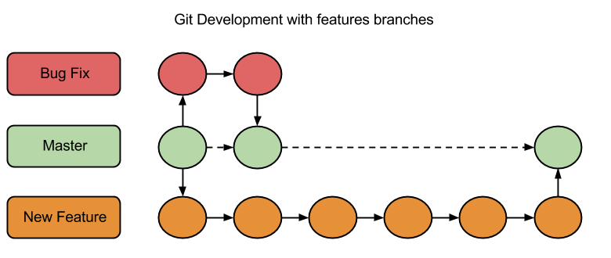
Branches in action
Branching allows each developer to branch out from the original code base and isolate their work from others. It also helps Git to easily merge versions later on.
A Git branch is essentially an
independent line of development.
You can take advantage of
branching when working on new
features or bug fixes because it
isolates your work from that of other
team members.

Slide 5
GIT commands
Create a new branch
git checkout –b [your_branch_name]
List all branches
git branch
Delete your local branch
git branch –d [your_branch_name]
Delete your remote branch
git push origin :[your_branch_name]

Slide 6
Stashing
Stashing is used when we used to store the source code as ref for future reference)
Repo
Code placed for
Future reference

Slide 7

Collaboration

